Slide 1
Next Item Recommendation
A Multi-Scale Quasi-RNN Architecture for Next Item Recommendation

Slide 2

Project objective
Implement a Sequential Recommender System that recommends the next item based on the previous records.

Slide 3
Key Idea:Quasi-Recurrent Neural Networks
An approach to neural sequence modeling that alternates convolutional layers and a minimalist recurrent pooling function.

Slide 4


Data Preprocessing
Given U , the sets of users, I , the sets of items, each user is associated with a sequence of items he/she has interacted with in the past,......
Each item in the sequence of length L will be mapped into a latent space with dimension d, as xut−i+1 ∈ Rd an , I ∈ [1,2,...,L] at time step t−i+1.
Result is a sequence embedding matrix of user u before time step t which concatenates all the item embeddings in the sequence.

Slide 5
Methodology
The model takes User-item interaction sequence embeddings as input to the convolutional filters with 1 to full length of it.
Different union-level features are extracted and fed into a recurrent structure for better sequential representation learning.
Hierarchical summation aggregation (HSA) strategy is used to aggregate the outputs of each level in the whole architecture, which counts every unit cell and component output evenly contributed.
P, the user embedding or profile, which represents user general preference, is concatenated with results of HSA, to pass to a fully-connected layer to obtain scores for candidate items.

Slide 6
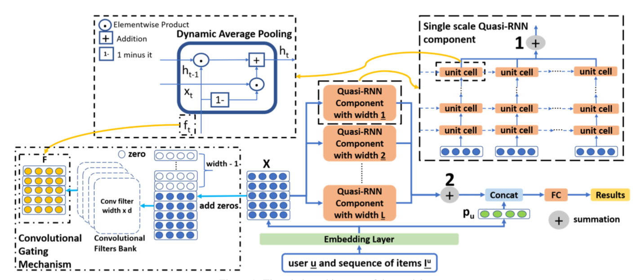

Slide 7

Training the Model
We used binary cross-entropy loss as the objective function to minimize.
The model parameters, Item and User Embeddings, Convolutional Weights and other neural network parameters are all learned by minimizing the objective function on the training set.
Evaluation Metrics: MAP (Mean Average Precision) and Recall@10.

Slide 8
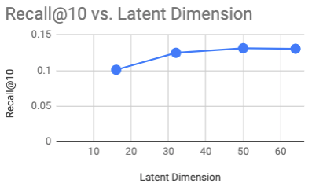
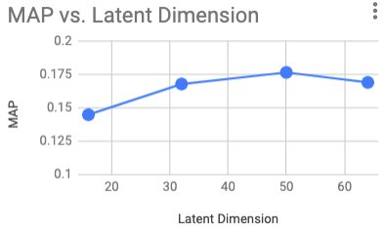
Results

Slide 9
References
[Balduzzi and Ghifary, 2016] David Balduzzi and Muhammad Ghifary. Strongly-typed recurrent neural networks. PMLR, 2016.
[Bradbury et al., 2016] James Bradbury, Stephen Merity, Caiming Xiong, and Richard Socher. Quasi-recurrent neural networks. arXiv preprint 1611.01576, 2016.
[Chen et al., 2018] Xu Chen, Hongteng Xu, Yongfeng Zhang, Jiaxi Tang, Yixin Cao, Zheng Qin, and Hongyuan Zha. Sequential recommendation with user memory net- works. In WSDM, 2018.
[Quadrana et al., 2018] Massimo Quadrana, Paolo Cremonesi, and Dietmar Jannach. Sequence-aware recommender systems. ACM Computing Surveys (CSUR), 2018.

